Slide 1

CERTIFICATE III IN AUTOMOTIVE REPAIR & MAINTENANCE
SUBJECT: AUTOMOTIVE ENGINE PRACTICE
By Ibrahim siraj
Maldives polytechnic

Slide 2
AUTOMOTIVE ENGINE PRACTICE
Chapter 3 Common Faults and Rectification of an Internal Combustion Engine
Introduction
Even a well-maintained engine can develop faults over time due to:
Wear and tear
Improper maintenance
Fuel or lubrication issues
Overheating or contamination
Understanding common faults helps in quick diagnosis and effective repair.
By Ibrahim siraj
Maldives polytechnic

Slide 3
AUTOMOTIVE ENGINE PRACTICE
Chapter 3 Common Faults and Rectification of an Internal Combustion Engine
Objectives
By the end of this presentation, you will be able to:
Identify common engine faults.
Understand their causes and symptoms.
Learn basic rectification (repair) methods.
By Ibrahim siraj
Maldives polytechnic

Slide 4
AUTOMOTIVE ENGINE PRACTICE
Chapter 3 Common Faults and Rectification of an Internal Combustion Engine
Classification of Engine Faults
Starting Faults
Performance Faults
Overheating Faults
Lubrication Faults
Combustion / Firing Faults
Mechanical / Noise Faults
By Ibrahim siraj
Maldives polytechnic

Slide 5
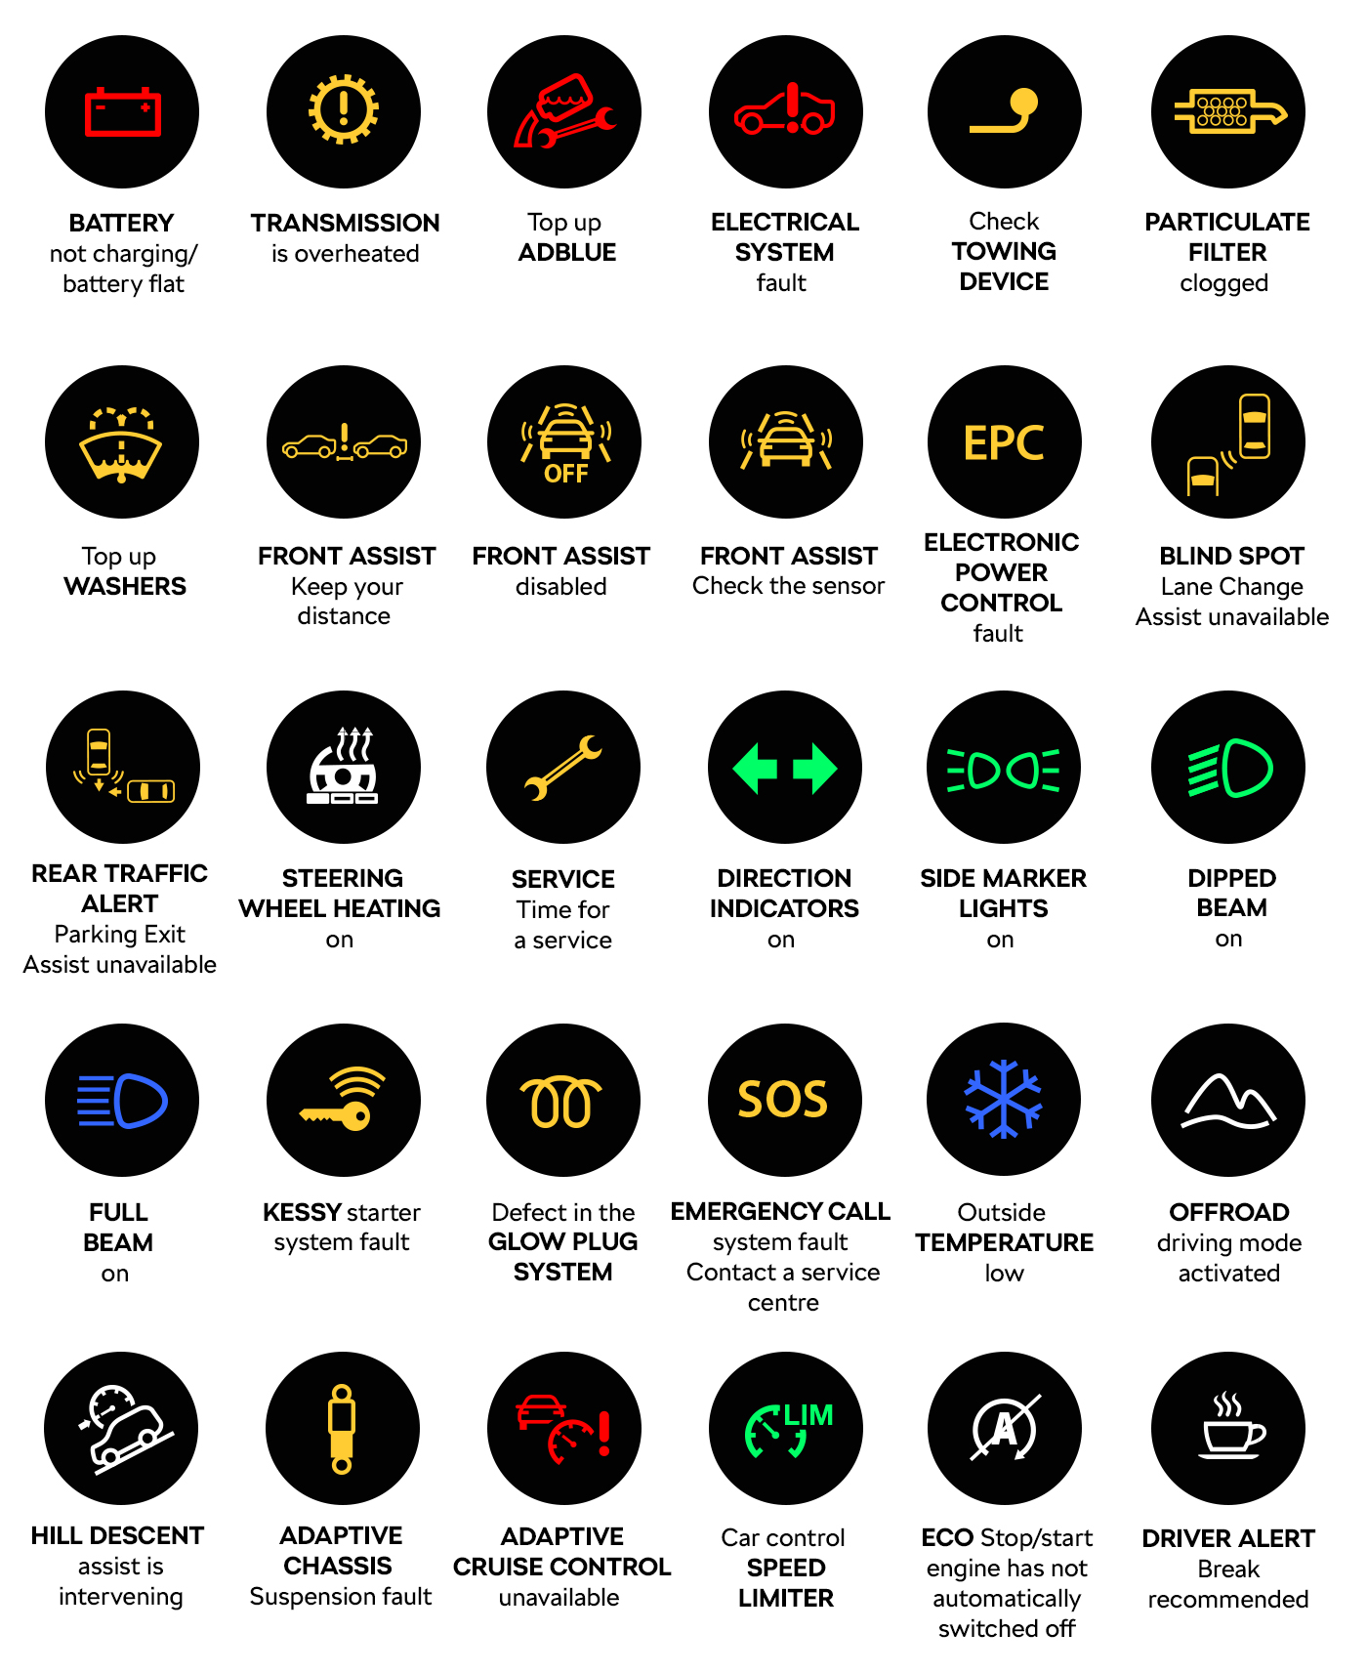
AUTOMOTIVE ENGINE PRACTICE
Chapter 4 Common Faults and Rectification of an Internal Combustion Engine
Classification of Engine Faults
Starting Faults
Performance Faults
Overheating Faults
Lubrication Faults
Combustion / Firing Faults
Mechanical / Noise Faults
By Ibrahim siraj
Maldives polytechnic

Slide 6
AUTOMOTIVE ENGINE PRACTICE
Chapter 3 Common Faults and Rectification of an Internal Combustion Engine
Common Starting Faults
Fault | Possible Cause | Rectification
Engine fails to start | Weak or dead battery | Recharge or replace battery
Hard starting | Faulty spark plug or ignition coil | Clean or replace spark plug
Poor compression | Worn piston rings or valves | Replace worn components
Fuel not reaching carburetor/injector | Blocked fuel line or filter | Clean fuel system
By Ibrahim siraj
Maldives polytechnic

Slide 7
AUTOMOTIVE ENGINE PRACTICE
Chapter 3 Common Faults and Rectification of an Internal Combustion Engine
Common Starting Faults
Engine fail to start
Weak or dead battery: The most common cause. Your dashboard lights might flicker, or all power may be completely off. This can happen if you leave an interior light on, or due to a bad alternator not charging the battery
What to do: Jump-start the vehicle. If it starts, it confirms a battery or alternator issue. Drive to an auto parts store to get them tested.
Corroded battery terminals: Dirty or loose connections on the battery posts can prevent proper electrical flow.
What to do: Inspect the terminals for white or greenish build-up. Carefully disconnect and clean them with a wire brush or a solution of baking soda and water.
By Ibrahim siraj
Maldives polytechnic

Slide 8
AUTOMOTIVE ENGINE PRACTICE
Chapter 3 Common Faults and Rectification of an Internal Combustion Engine
Common Starting Faults
Engine fail to start
Bad starter motor: If the battery is healthy, the starter motor may be faulty. A single loud click when turning the key suggests the starter solenoid has failed.
What to do: If the battery and connections are fine, the starter motor likely needs to be replaced by a mechanic
Faulty ignition switch: The switch can fail to send the necessary power to the starter. If you have lights but no cranking, the switch could be the culprit.
Park/neutral safety switch failure: Your car has a safety switch that prevents starting while in gear. If this switch is faulty, the car will not start even if the shifter is in "Park".
What to do: Try starting the vehicle in neutral, which uses a different part of the switch.
By Ibrahim siraj
Maldives polytechnic

Slide 9
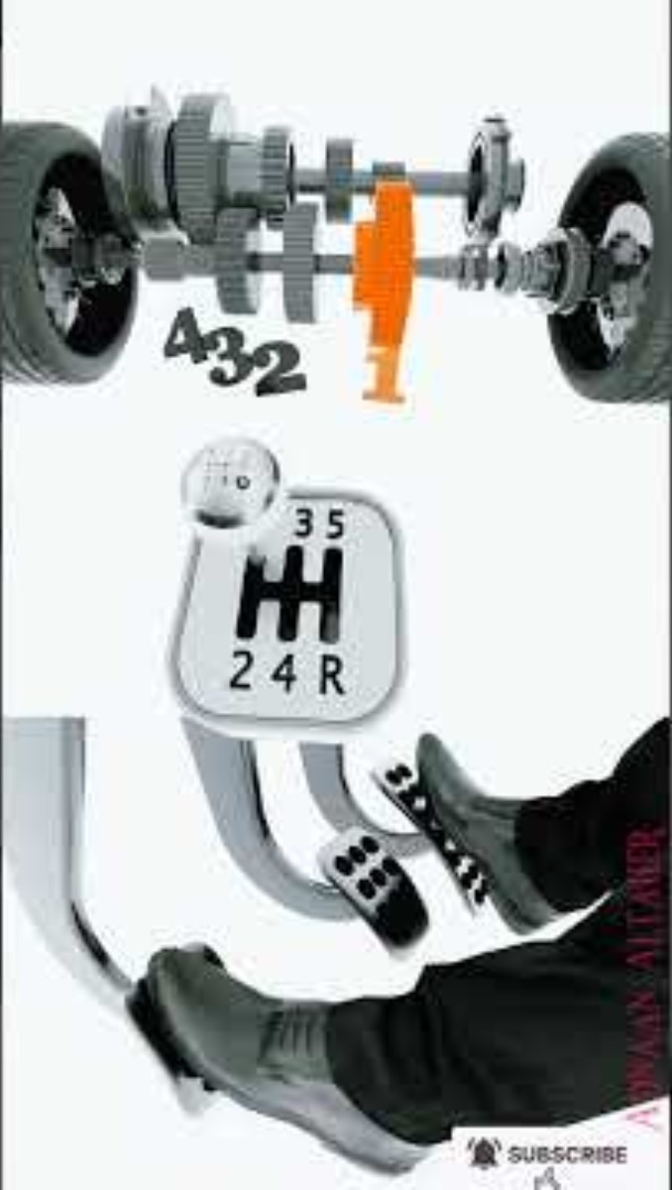
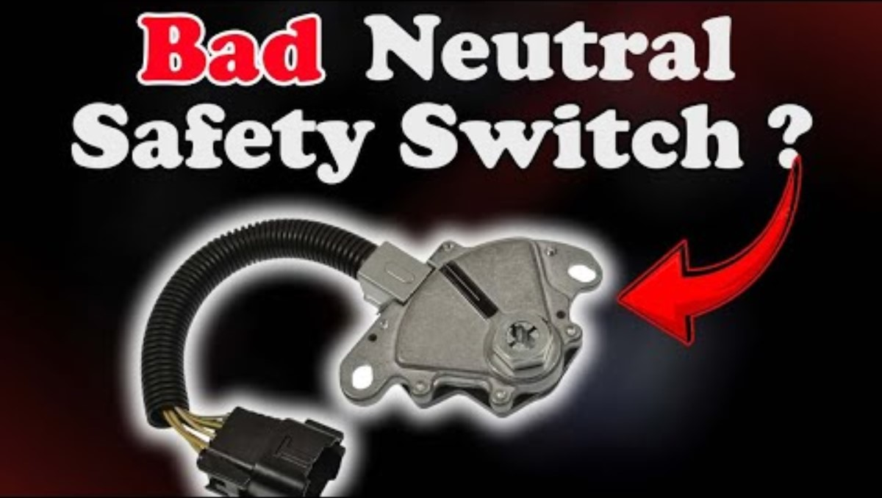
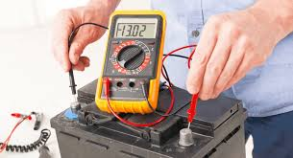
AUTOMOTIVE ENGINE PRACTICE
Chapter 3 Common Faults and Rectification of an Internal Combustion Engine
Common Starting Faults
Engine fail to start
Park/neutral safety switch failure: Your car has a safety switch that prevents starting while in gear. If this switch is faulty, the car will not start even if the shifter is in "Park".
What to do: Try starting the vehicle in neutral, which uses a different part of the switch.
By Ibrahim siraj
Maldives polytechnic

Slide 10
AUTOMOTIVE ENGINE PRACTICE
Chapter 3 Common Faults and Rectification of an Internal Combustion Engine
Common Starting Faults
Hard Starting
If the engine cranks but won't start
This means the starter is working, but the engine isn't completing the combustion cycle. The issue is likely with the fuel or spark
No fuel: You might have a faulty fuel gauge or are simply out of gas.
What to do: Add fuel to your tank and see if it starts
Bad fuel pump or relay: The fuel pump moves gas from the tank to the engine. If it fails, the engine gets no fuel.
What to do: Turn the key to the "on" position (without starting) and listen for a two-second hum from the rear of the car, which indicates the fuel pump is priming.
Clogged fuel filter: A dirty filter can restrict fuel flow and starve the engine. It's often a contributing factor rather than the sole cause.
By Ibrahim siraj
Maldives polytechnic

Slide 11
AUTOMOTIVE ENGINE PRACTICE
Chapter 3 Common Faults and Rectification of an Internal Combustion Engine
Common Starting Faults
Hard Starting
If the engine cranks but won't start
No spark: A lack of spark can be caused by failed spark plugs or ignition coils, which ignite the fuel. A bad crank position sensor can also prevent the engine computer from knowing when to send the spark.
Broken timing belt or chain: If you hear the engine cranking faster than normal, the timing belt may have snapped. This is a severe problem that will require towing.
What to do next
Determine the sound: Listen carefully when you turn the key. Does it click, crank, or do nothing?
Perform basic checks: Start with the simplest fixes. Is the car in park? Do you have enough gas? Are the battery terminals clean and tight?
Try a jump-start: This is a good way to determine if a weak battery is the problem.
Know when to call a pro: If a jump-start doesn't work or the problem seems to be with the starter, ignition, or fuel pump, it's best to have a qualified mechanic diagnose and repair the vehicle.
By Ibrahim siraj
Maldives polytechnic

Slide 12
AUTOMOTIVE ENGINE PRACTICE
Chapter 3 Common Faults and Rectification of an Internal Combustion Engine
Common Starting Faults
Poor Compression
Symptoms of poor compression
Difficulty starting: The engine may crank normally but fail to start, especially when cold. If compression is low across all cylinders, the engine will spin faster than normal and not start at all.
Rough idle: An engine with poor compression in one or more cylinders will often have a rough or shaky idle
Reduced power: You may notice sluggish acceleration and a significant loss of overall power.
Misfires: Insufficient cylinder pressure can cause misfires, leading to the engine stumbling or jerking, especially under load
Increased oil consumption: Worn rings can allow oil to enter the combustion chamber, leading to excessive oil consumption and blue smoke from the exhaust.
Increased fuel consumption: The engine may use more fuel to compensate for inefficient combustion
By Ibrahim siraj
Maldives polytechnic

Slide 13
AUTOMOTIVE ENGINE PRACTICE
Chapter 3 Common Faults and Rectification of an Internal Combustion Engine
Common Starting Faults
Poor Compression
Symptoms of poor compression
Abnormal exhaust smoke:
Blue smoke: Indicates oil is burning, often from worn piston rings or valve seals.
White smoke: Can point to a blown head gasket, which allows coolant to mix with the oil or enter the combustion chamber.
Common causes
Worn piston rings: The rings on the piston seal against the cylinder wall to contain combustion pressure. Worn, broken, or carbonized rings will allow pressure to escape.
Damaged valves: Intake or exhaust valves that are burnt, bent, or not properly seated can leak, preventing the combustion chamber from sealing.
Blown head gasket: The gasket that seals the cylinder head to the engine block can fail, allowing combustion gases to leak. A gasket breach between two cylinders will cause low compression in both.
Worn cylinder walls: In high-mileage engines, the cylinder walls can become worn or scored, which prevents the piston rings from creating a tight seal.
Improper timing: A slipped or broken timing belt/chain can throw off the valve timing, causing them to open and close at the wrong time and leak compression.
By Ibrahim siraj
Maldives polytechnic

Slide 14
AUTOMOTIVE ENGINE PRACTICE
Chapter 3 Common Faults and Rectification of an Internal Combustion Engine
Common Starting Faults
Fuel Not reaching Carburetor issue
Check the fuel level. This may seem obvious, but make sure the tank has a sufficient amount of fresh gasoline.
Verify the fuel shut-off valve. For equipment like lawnmowers, make sure the fuel petcock or shut-off valve is in the "on" or "open" position.
Inspect the fuel lines. Follow the lines from the tank to the carburetor. Look for any kinks, cracks, or signs of blockage.
By Ibrahim siraj
Maldives polytechnic

Slide 15
AUTOMOTIVE ENGINE PRACTICE
Chapter 3 Common Faults and Rectification of an Internal Combustion Engine
Poor Engine Performance
Symptom | Possible Cause | Rectification
Lack of power | Clogged air filter or fuel injector | Clean or replace
Engine misfires | Faulty spark plug, plug wire, or injector | Inspect and replace
High fuel consumption | Incorrect carburetor/injection setting | Tune the fuel system
Irregular idling | Vacuum leak or improper timing | Adjust timing and check hoses
By Ibrahim siraj
Maldives polytechnic

Slide 16
AUTOMOTIVE ENGINE PRACTICE
Chapter 3 Common Faults and Rectification of an Internal Combustion Engine
Engine Overheating Faults
Fault | Cause | Rectification
Engine temperature too high | Low coolant level or leaking radiator | Refill coolant, repair leak
Thermostat stuck closed | Faulty thermostat | Replace thermostat
Blocked radiator fins | Dirt or debris | Clean radiator
Water pump failure | Broken impeller or belt | Replace defective parts
By Ibrahim siraj
Maldives polytechnic

Slide 17
AUTOMOTIVE ENGINE PRACTICE
Chapter 3 Common Faults and Rectification of an Internal Combustion Engine
Lubrication System Faults
Fault | Cause | Rectification
Low oil pressure | Insufficient oil or clogged filter | Add oil, replace filter
Excessive oil consumption | Worn piston rings or valve seals | Replace worn parts
Engine knocking | Wrong oil grade or low oil | Use correct grade, refill
Oil leakage | Damaged gasket or seal | Replace gasket/seal
By Ibrahim siraj
Maldives polytechnic

Slide 18
AUTOMOTIVE ENGINE PRACTICE
Chapter 3 Common Faults and Rectification of an Internal Combustion Engine
Combustion / Firing Faults
Fault | Cause | Rectification
Pre-ignition (engine knocking) | Low octane fuel, carbon deposits | Use correct fuel, clean chamber
Backfiring | Incorrect ignition timing | Adjust timing
Detonation | Overheating or high compression | Cool engine, check compression
Smoke emission | Faulty injector or carburetor setting | Adjust or replace
By Ibrahim siraj
Maldives polytechnic

Slide 19
AUTOMOTIVE ENGINE PRACTICE
Chapter 3 Common Faults and Rectification of an Internal Combustion Engine
Types of Exhaust Smoke and Their Causes
Smoke Color | Possible Cause | Rectification
Black Smoke | Excess fuel / rich mixture | Adjust air-fuel ratio
Blue Smoke | Oil burning (worn rings, valve seals) | Replace worn components
White Smoke | Coolant leakage into combustion chamber | Check head gasket, repair leak
By Ibrahim siraj
Maldives polytechnic

Slide 20
AUTOMOTIVE ENGINE PRACTICE
Chapter 3 Common Faults and Rectification of an Internal Combustion Engine
Mechanical Faults (Noise & Vibration)
Symptom | Cause | Rectification
Knocking sound | Loose connecting rod or worn bearing | Tighten or replace parts
Tapping noise | Incorrect valve clearance | Adjust clearance
Vibrations | Unbalanced crankshaft or loose mounts | Balance and tighten
Timing chain noise | Slack or worn chain | Replace or adjust chain tensioner
By Ibrahim siraj
Maldives polytechnic

Slide 21
AUTOMOTIVE ENGINE PRACTICE
Chapter 3 Common Faults and Rectification of an Internal Combustion Engine
Diagnostic Tools Used
Compression tester
Vacuum gauge
Multimeter (for electrical faults)
Engine scanner (OBD-II)
Stethoscope (for detecting internal noises)
By Ibrahim siraj
Maldives polytechnic

Slide 22
AUTOMOTIVE ENGINE PRACTICE
Chapter 3 Common Faults and Rectification of an Internal Combustion Engine
Preventive Maintenance Tips
Regular oil and filter change
Maintain correct coolant level
Use manufacturer-recommended fuel and oil
Periodic cleaning of air and fuel filters
Check spark plugs and timing regularly
Avoid engine overload and overheating
By Ibrahim siraj
Maldives polytechnic

Slide 23
AUTOMOTIVE ENGINE PRACTICE
Chapter 3 Common Faults and Rectification of an Internal Combustion Engine
Summary
Most engine faults arise from neglect or poor maintenance.
Early diagnosis prevents costly repairs.
Understanding symptoms helps in quick rectification and ensures long engine life.
By Ibrahim siraj
Maldives polytechnic

Slide 24
AUTOMOTIVE ENGINE PRACTICE
Chapter 3 Common Faults and Rectification of an Internal Combustion Engine
Conclusion
The efficiency and reliability of an engine depend on proper inspection, maintenance, and timely repairs.
Preventive care is more cost-effective than major overhaul.
Skilled technicians play a vital role in fault diagnosis and correction.
By Ibrahim siraj
Maldives polytechnic

Slide 25
AUTOMOTIVE ENGINE PRACTICE
Chapter 3 Common Faults and Rectification of an Internal Combustion Engine
References
Internal Combustion Engines by V. Ganesan
Automobile Mechanics by Joseph Heitner
Manufacturer service manuals (Toyota, Cummins, Honda)
SAE Technical Papers
By Ibrahim siraj
Maldives polytechnic

Slide 26
THANK YOU

